Slide 1

Using Perseus
Texts and the Word Study Tool
Gregory Crane, Anna Krohn, 2015

Slide 2
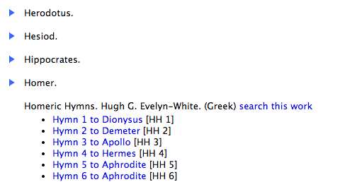
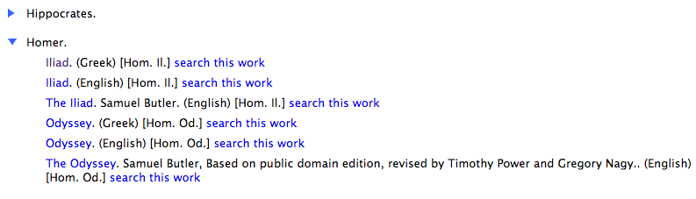
Find Texts
http://www.perseus.tufts.edu/hopper/collection?collection=Perseus:collection:Greco-Roman
-Alphabetical by author

Slide 3
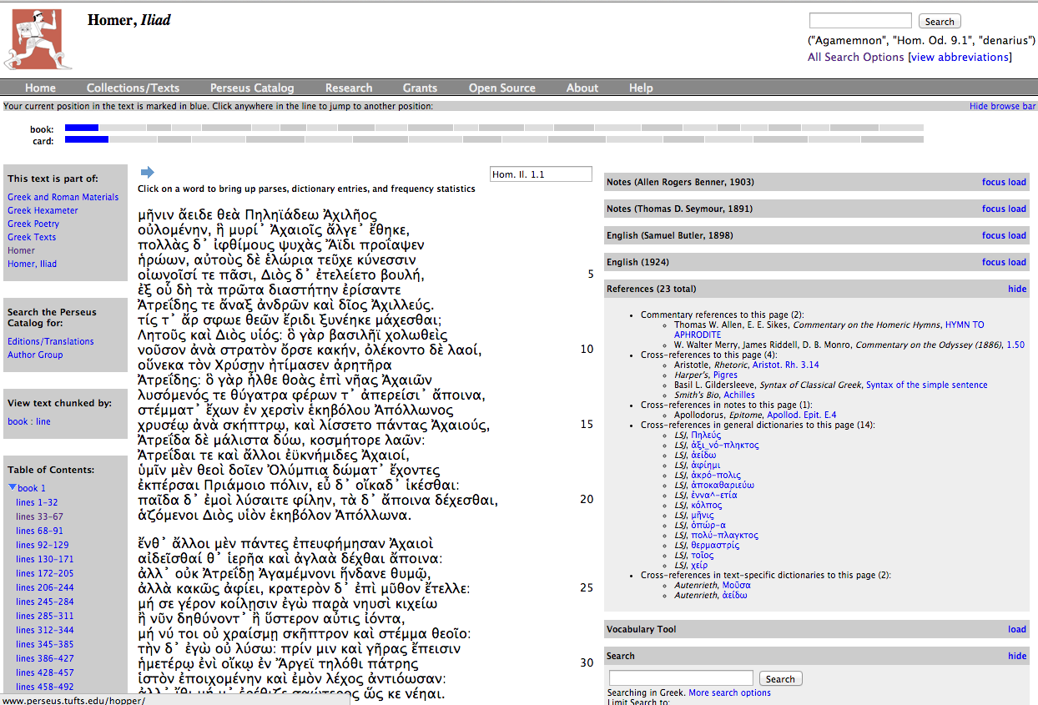
Using Texts
http://www.perseus.tufts.edu/hopper/text?doc=Perseus%3atext%3a1999.01.0133
-Text tools
-Navigation
-within a text
-between English
and Greek or Latin
-Search
-Vocabulary lookup

Slide 4
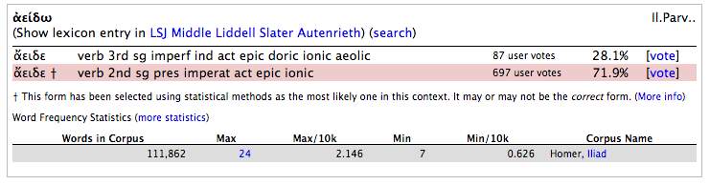
Word Study Tool (Greek)
http://www.perseus.tufts.edu/hopper/morph?l=a%29%2Feide&la=greek&can=a%29%2Feide0&prior=mh=nin&d=Perseus:text:1999.01.0133:book=1:card=1&i=1#lexicon
Full dictionary entry links
Dictionary form
Simple definition
Possible word forms
Word frequency statistics

Slide 5
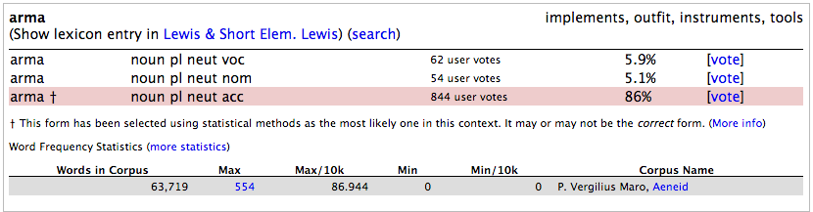
Word Study Tool (Latin)
http://www.perseus.tufts.edu/hopper/morph?l=Arma&la=la&can=arma0&d=Perseus:text:1999.02.0055:book=1:card=1&i=1
Full dictionary entry links
Simple definition
Dictionary form
Possible word forms
Word frequency statistics

Slide 6
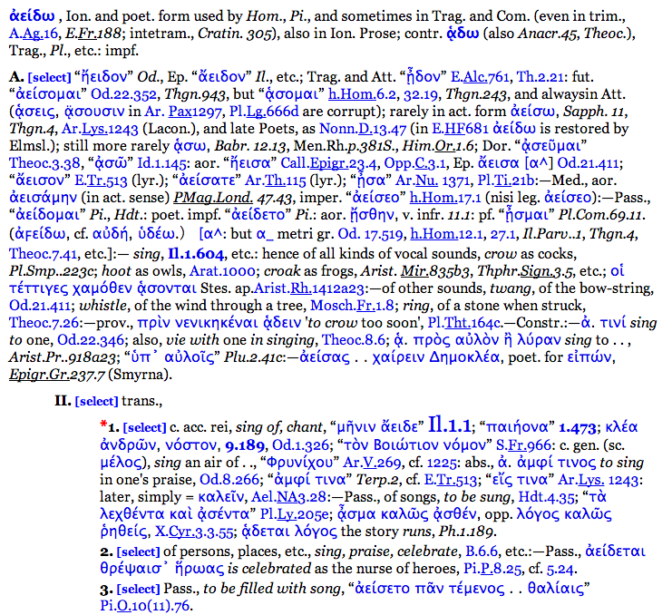
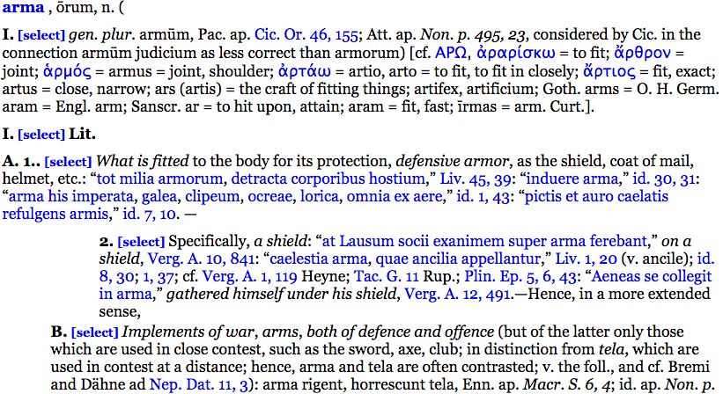
Guide to dictionary entries
-Where’s the definition??
-LSJ and Lewis & Short, very, very detailed entries with lots of examples from other texts
-harder to navigate

Slide 7
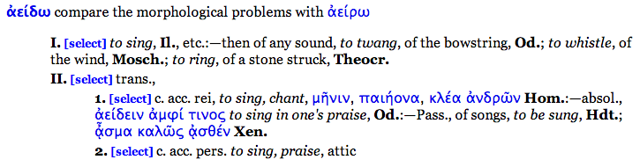
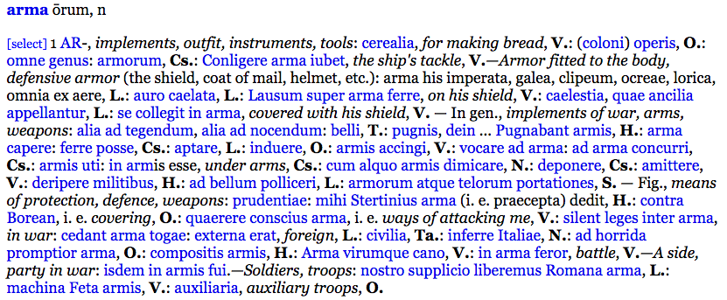
Guide to dictionary entries
-Middle Liddell and Elem. Lewis
-much more manageable, but not all words will have an entry

Slide 8
Common problems
-The simple definition is meaningless!
-Cause: automation error
-Solution: look at the full dictionary entry
-The word study tool doesn’t find a definition for the word.
-Cause: word is probably a name or a one-off compound
-Solution: if a name, try looking at the English, if a strange compound, try taking the first part of the word and entering that separately into the word search, or just consult the English
-Things are taking forever to load!
-Cause: server issues
-Solution: refresh the page or click again on the link

